Slide 1
12:02:18 PM
LECTURE 6

Slide 2
SPECIAL UNIVARIATE DISTRIBUTIONS
Bernoulli
Binomial
Poisson

Slide 3
BERNOULLI TRIALS
Named after the Swiss mathematician, James Bernoulli. Bernoulli r.v’s are perhaps the simplest type of random variables, in which there are only two possible outcomes. One outcome is usually called success denoted by s and the other outcome is called failure, denoted f. For example in tossing a coin there are two possible outcomes, H or T. If our interest is head, H-success, then tail T is a failure.

Slide 4




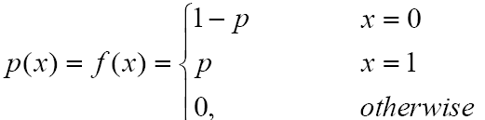
BERNOULLI TRIALS

Slide 5


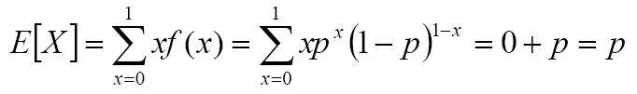


BERNOULLI TRIALS

Slide 6
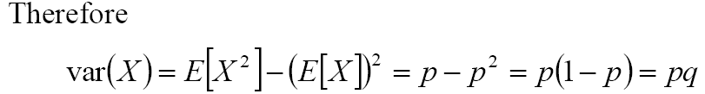







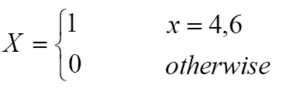
BERNOULLI TRIALS

Slide 7

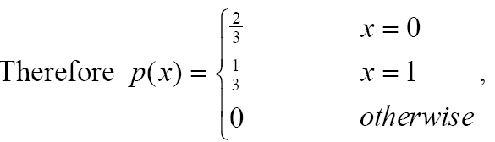



BERNOULLI TRIALS

Slide 8




BINOMIAL DISTRIBUTION

Slide 9
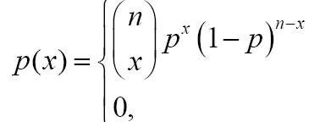
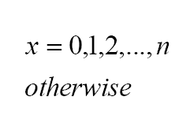




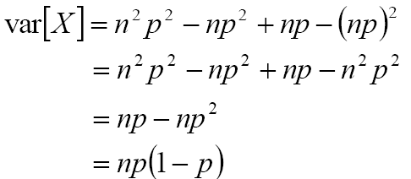
BINOMIAL DISTRIBUTION

Slide 10
BINOMIAL DISTRIBUTION
A particular long traffic light on your morning commuter lane is green 20% of the time that you approach it. Assuming that each morning is unique (independent).
Over five mornings, what is the probability that the light is green on exactly one day?
Over 20 mornings, what is the probability that the light is green on exactly four days?
Over 20 mornings, what is the probability that the light is green on more than four days?

Slide 11

BINOMIAL DISTRIBUTION
A manufacturer has 100 memory chips in stock, 4 % of which are likely to be defective (based on past experience). A random sample of 20 chips is selected and shipped to a factory that assembles laptops. Let X denote the number of computers that receive faulty memory chips. Find;
the probability mass function of X.
the probability Exactly fifteen computers will be faulty.
the probability that at least three but not more than seven computers will be faulty.
the mean and standard deviation of .

Slide 12

BINOMIAL DISTRIBUTION
A pharmaceutical researcher working on cure of baldness noticed that middle aged men are bolding at the crown of their head have a 45 % probability of suffering a heart attack over the next decade. In a sample of ten middle-age men, find the following;
probability distribution of the number of men who will suffer a heart attack in the next decade
probability that more than five will suffer a heart attack
probability that at least three but at most six will suffer a heat attach

Slide 13
BINOMIAL DISTRIBUTION
Example 4
A multiple-choice trivia quiz has ten questions, each with five possible answers. If someone simply guesses at each answer, what is the
probability of only one or two correct guesses?
probability of getting more than half the questions right?
expected number of correct guesses?

Slide 14
BINOMIAL DISTRIBUTION
Example 5
Caribbean Coffee prints coupon under the rims of 20% of its paper cups. If you buy ten cups of coffee, determine the following:
a).The probability distribution of the prize coupons to be won.
b).The probability that exactly seven is the prize you would win.
c).The probability that you would win between three and eight.
d).The expected number of prize to be won.
e). The standard deviation of the prizes to be won.

Slide 15





POISON DISTRIBUTION

Slide 16


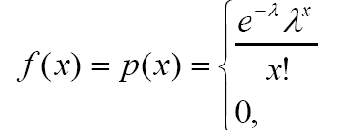
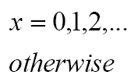





POISON DISTRIBUTION

Slide 17





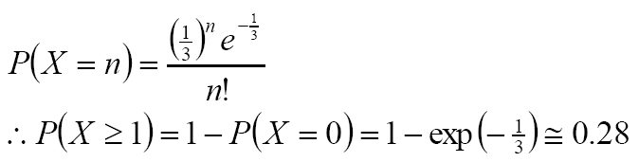
POISON DISTRIBUTION

Slide 18
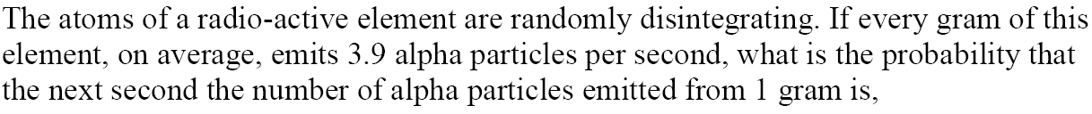
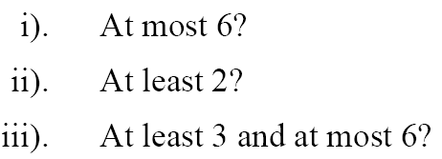
POISON DISTRIBUTION

Slide 19
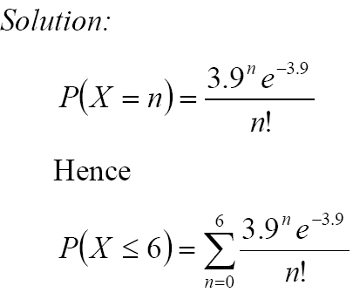

POISON DISTRIBUTION

Slide 20

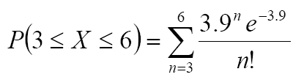

POISON DISTRIBUTION

Slide 21
POISON PROCESSN
In a Poisson set up, sometimes the time is a factor of interest, that is the number of events occurring in a given interval of time. If the events occur fulfil the following conditions :
Events occur at a constant rate
Their occurrence is a process or rare events
The events occurring in a non-overlapping interval of time are independent of each other

Slide 22
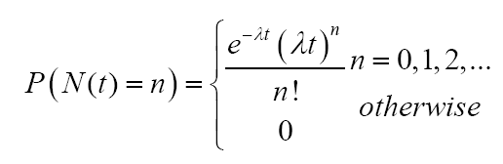
POISON PROCESSN
The above three conditions are known as Poisson postulates.
If the postulates are observe then the Poison Distribution is Modelled as a Poison Process where ,

Slide 23
POISON PROCESSN
For this distribution find the mean and variance.
Also find the distribution of the waiting time.

Slide 24
POISON PROCESSN
Example 1
The number of user of an automatic banking machine is Poison, the mean number of users per a 5 minute interval is 1.5. Determine the probability of the following events;
No users in the next five minutes
5 or fewer users in the next 15 minutes
3 or more users in the next 10 minutes

Slide 25
POISON PROCESSN
Example 2
Suppose that the arrival of patients at a local clinic in a certain small town is a Poisson process with rate three patients per hour. Calculate the probability that a doctor working in this clinic for two hours
Will receive no patient.
Will wait for at least 30 minutes before receiving the first patient.

Slide 26
POISON PROCESSN
Example 3
The number of people who arrive at a cashiers counter in a bank during a specified period of time often exhibits (approximately) a Poisson probability distribution. If we know the mean arrival rate , the Poisson probability distribution can be used to aid in the design of the customer service facility. Suppose you estimate that the mean number of arrivals per minute for cashier service at a bank is one person per minute,

Slide 27
POISON PROCESSN
Example 3 cont’
What is the probability that no customer will arrive in the first one minute?
What is the probability that in a given minute the number of arrivals will be at least three but at most five?

Slide 28
Geometric Distribution
Consider a random experiment that is closely related to the one used in the definition of a
binomial distribution.
Again, assume a series of Bernoulli trials (independent trials with constant probability p of a success on each trial).

Slide 29
Geometric Distribution
However, instead of a fixed number of trials, trials are conducted until a success is obtained. Let the random variable X denote the number of trials until the first success.

Slide 30
Geometric Distribution
Example
Let the random variable X denote the number of semiconductor wafers that need to be analyzed in order to detect a large particle of contamination.
Assume that the probability that a
wafer contains a large particle is 0.01 and that the wafers are independent. Determine the
probability distribution of X.

Slide 31
Geometric Distribution
Solution
Let p denote a wafer in which a large particle is present, and let a denote a wafer in which
it is absent. The sample space of the experiment is infinite, and it can be represented as all possible
sequences that start with a string of a’s and end with p. That is,

Slide 32

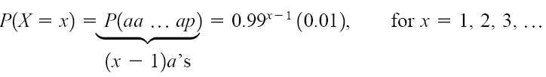
Geometric Distribution
Solution
Consider a few special cases. We have
Also, using the independence assumption
A general formula is

Slide 33


Geometric Distribution
Called the geometric Distribution.
Describing the probabilities associated with X in terms of this formula is the simplest method
of describing the distribution of X in this example.
Clearly . The fact that the sum of the probabilities is 1 is left as an exercise.

Slide 34


Geometric Distribution
If X is a geometric random variable with parameter p, then
Lack of Memory Property
A geometric random variable has been defined as the number of trials until the first success.
However, because the trials are independent, the count of the number of trials until the next

Slide 35
Geometric Distribution
A geometric random variable has been defined as the number of trials until the first success.
However, because the trials are independent, the count of the number of trials until the next success can be started at any trial without changing the probability distribution of the random variable. Hence it portrays Lack of Memory Property

Slide 36
Negative Binomial Distribution
A generalization of a geometric distribution in which the random variable is the number of
Bernoulli trials required to obtain r successes results in the negative binomial distribution.

Slide 37

Negative Binomial Distribution
In a series of Bernoulli trials (independent trials with constant probability p of a success),
let the random variable X denote the number of trials until r successes occur.
Then X is a negative binomial random variable with parameters and

Slide 38


Negative Binomial Distribution
If X is a negative binomial random variable with parameters p and r,

Slide 39
Negative Binomial Distribution
Example
A Web site contains three identical computer servers. Only one is used to operate the site, and the other two are spares that can be activated in case the primary system fails. The probability of a failure in the primary computer (or any activated spare system) from a request for service is 0.0005. Assuming that each request represents an independent trial, what is the mean number of requests until failure of all three servers?

Slide 40
Negative Binomial Distribution
Example cont’
Assuming that each request represents an independent trial,
What is the mean number of requests until failure of all three servers?
What is the probability that all three servers fail within five requests?

Slide 41
Negative Binomial Distribution
Solution
Let X denote the number of requests until all three servers fail, and let
denote the number of requests before a failure of the first, second, and third servers used, respectively.
Now, Also, the requests are assumed to comprise independent
trials with constant probability of failure
P= 0.0005.

Slide 42

Negative Binomial Distribution
Solution
Furthermore, a spare server is not
affected by the number of requests before it is activated. Therefore, X has a negative binomial
distribution with p =0.0005 and r = 3. Consequently,

Slide 43
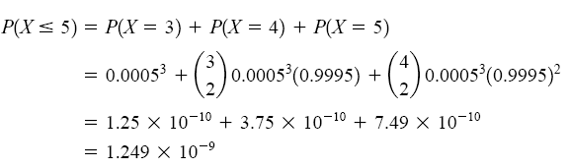
Negative Binomial Distribution
The probability is

Slide 44
Negative Binomial Distribution
Exercise 1
In a clinical study, volunteers are tested for a gene that has been found to increase the risk for a disease. The probability that a person carries the gene is 0.1.
(a) What is the probability 4 or more people will have to be tested before 2 with the gene are detected?
(b) How many people are expected to be tested before 2 with the gene are detected?

Slide 45
Negative Binomial Distribution
Exercise 2
In a clinical study, volunteers are tested for a gene that has been found to increase the risk for a disease. The probability that a person carries the gene is 0.1.
(a) What is the probability 4 or more people will have to be tested before 2 with the gene are detected?
(b) How many people are expected to be tested before 2 with the gene are detected?

Slide 46
Negative Binomial Distribution
Exercise 3
The probability of a successful optical alignment in the assembly of an optical data storage product is 0.8. Assume the trials are independent.
(a) What is the probability that the first successful alignment requires exactly four trials?
(b) What is the probability that the first successful alignment requires at most four trials?

Slide 47
Negative Binomial Distribution
Exercise 3 cont’
(c) What is the probability that the first successful alignment requires at least four trials?

Slide 48
12:02:20 PM
END OF LECTURE 5

